Slide 1
The Art Dealer Game
Niharika Akula
Nikhilesh Yadav Vanguru

Slide 2
Introduction
In this presentation, my aim is to illustrate the educational journey offered by “The Art Dealer Game.”
I will present how the game progressively guides students from Grades K-2 to Grades 3-5 and finally to Grades 6-8.
The presentation will highlight how each stage introduces new challenges patterns and data analysis skills, fostering a seamless transition as students advance through their academic year.

Slide 3
Objective
K-2: Develop an understanding of fundamental patterns by recognizing card colors and suits, fostering early pattern recognition skills.
Grades 3-5: Enhance pattern recognition for identifying more intricate associations such as card combinations that add up to specific numbers and recognizing prime numbers.
Grades 6-8: Master the ability to analyze complex patterns including those relevant to poker hands while also navigating larger data sets to make informed judgements and interpretations.

Slide 4
Game Overview
“The Art Dealer Game” is an interactive educational tool designated to engage game players across different grade levels.
The primary objective of the game is unravel the preferences of an art dealer by strategically presenting sets of four playing cards from a standard deck of 52.
As my progress through k-2, 3-5 and 6-8 levels, the complexity of the patterns and data involved increase.
By observing the cards that the art dealer selects in each turn, decipher patterns and relationships.
This activity nurtures pattern recognition, data interpretation and critical thinking skills.

Slide 5
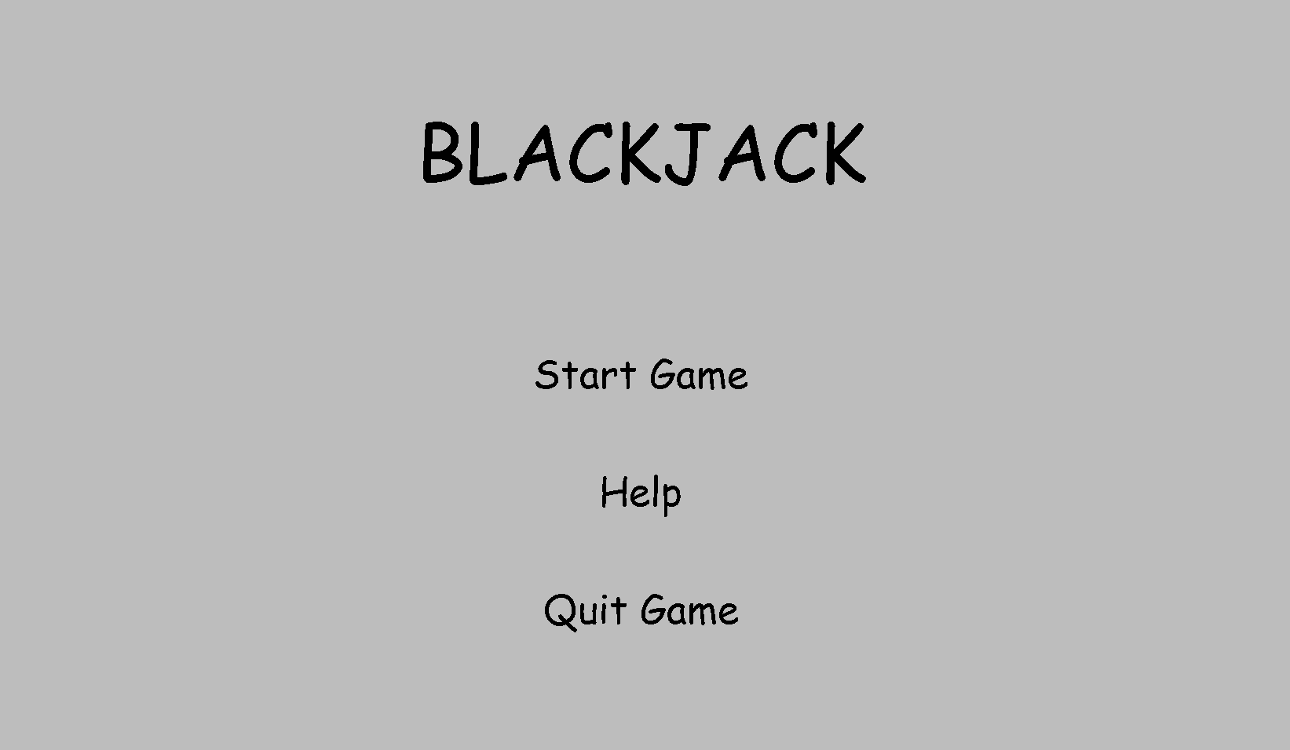
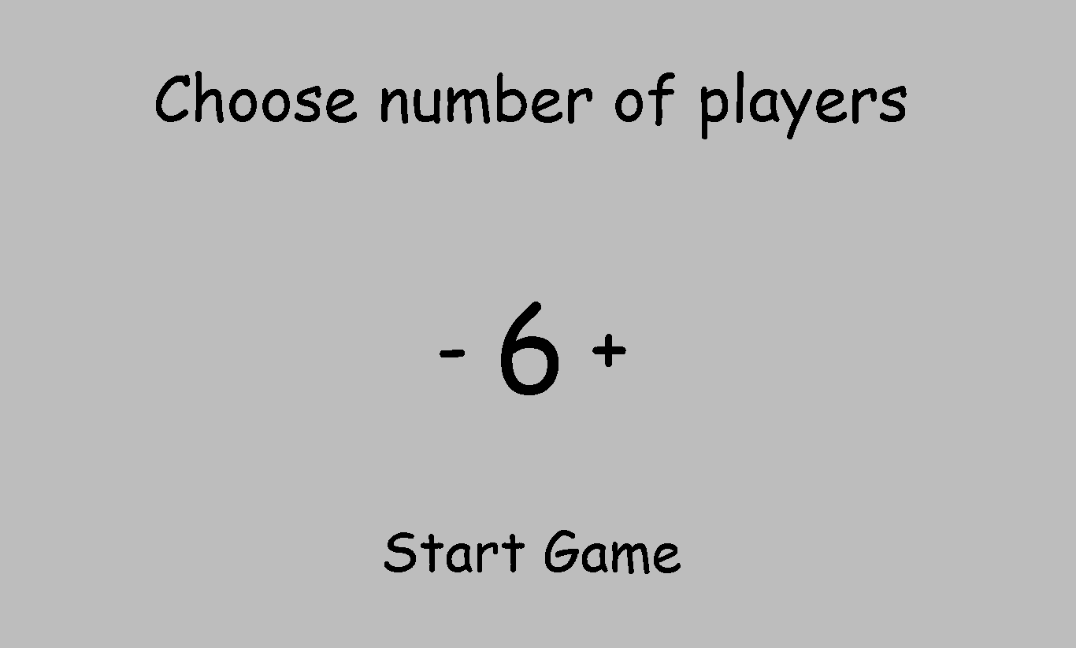
Visual Start Game

Slide 6
K-2 Level
The K-2 level in the game is easy to understand, the game cards have two same colour which is red and black. And also the same shape.
The gamer needs to take four card which the art dealer likes and also inform why those card are special.
This games helps kids to understand the things which looks same and different.
This game helps to kids for gain knowledge about shapes and colours.

Slide 7
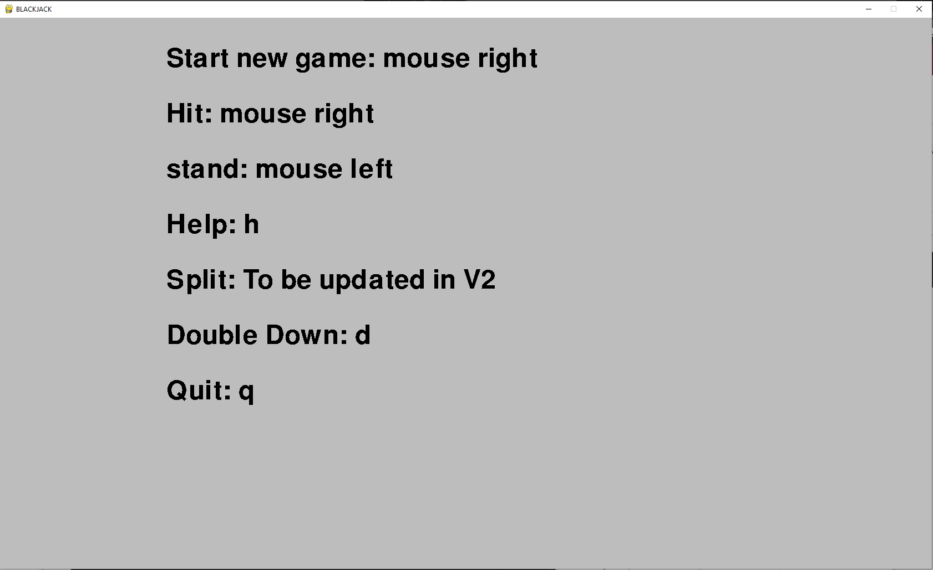
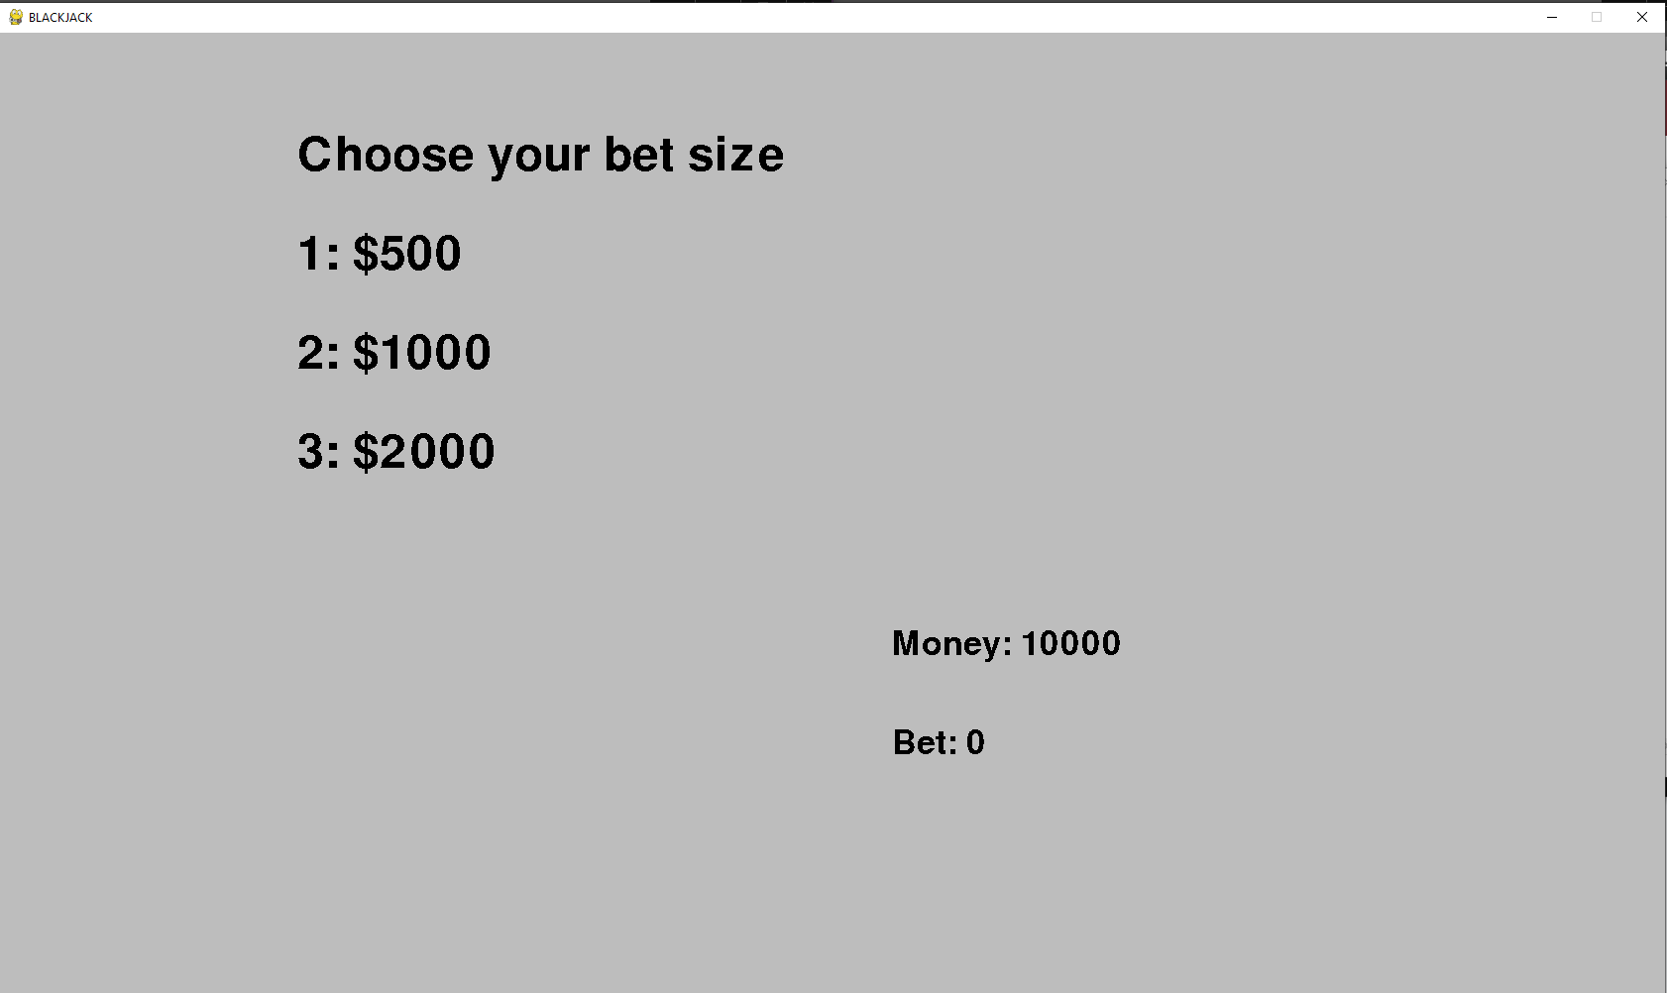
Instruction for K-2 Level

Slide 8
K-2 Gameplay
In this game the art dealer choose some of cards, kids notice the card which the dealer like and also think why dealer choose the card.
This games helps the kids to be good at findings pattern in a funway.
Through this game kids thinking about why dealer choose the cards, this games helps to increased their thinking skills.
Though this game kids learn how to play with cards.

Slide 9
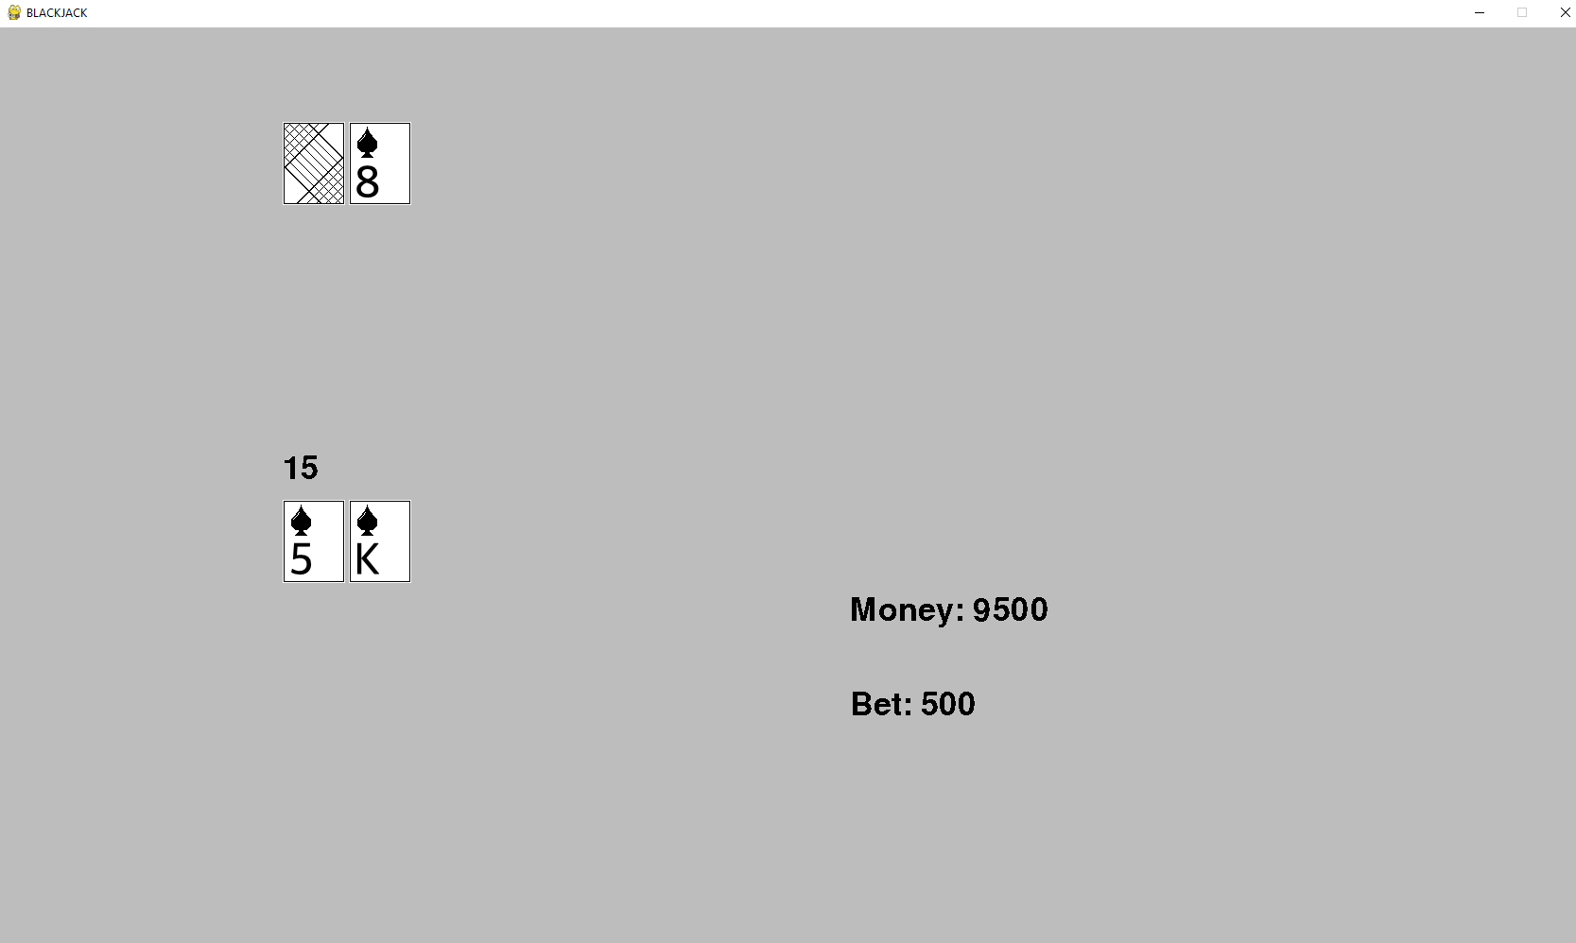
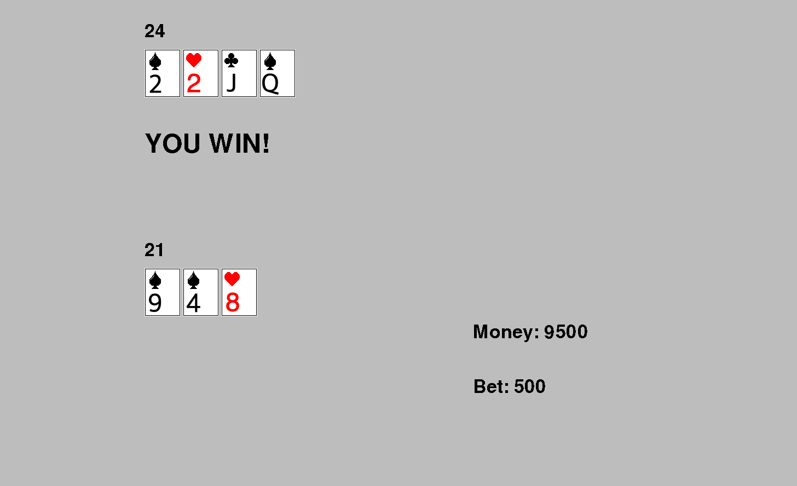
Gameplay for K-2 level

Slide 10
3-5 Level
As a player progress to Grades 3-5 in “The Art Dealer Game,” they encounter more intricate patterns that stimulate critical thinking.
These include recognizing prime numbers within the set of cards or presenting combinations that sum up to 9.
By incorporating these challenging yet captivating patterns. Players are encouraged to explore mathematical relationship and developer deeper understanding of data associations.
The transition from simpler patterns to these more complex ones sharpenses they analytics skill, preparing them to decipher nuanced information effectively.

Slide 11

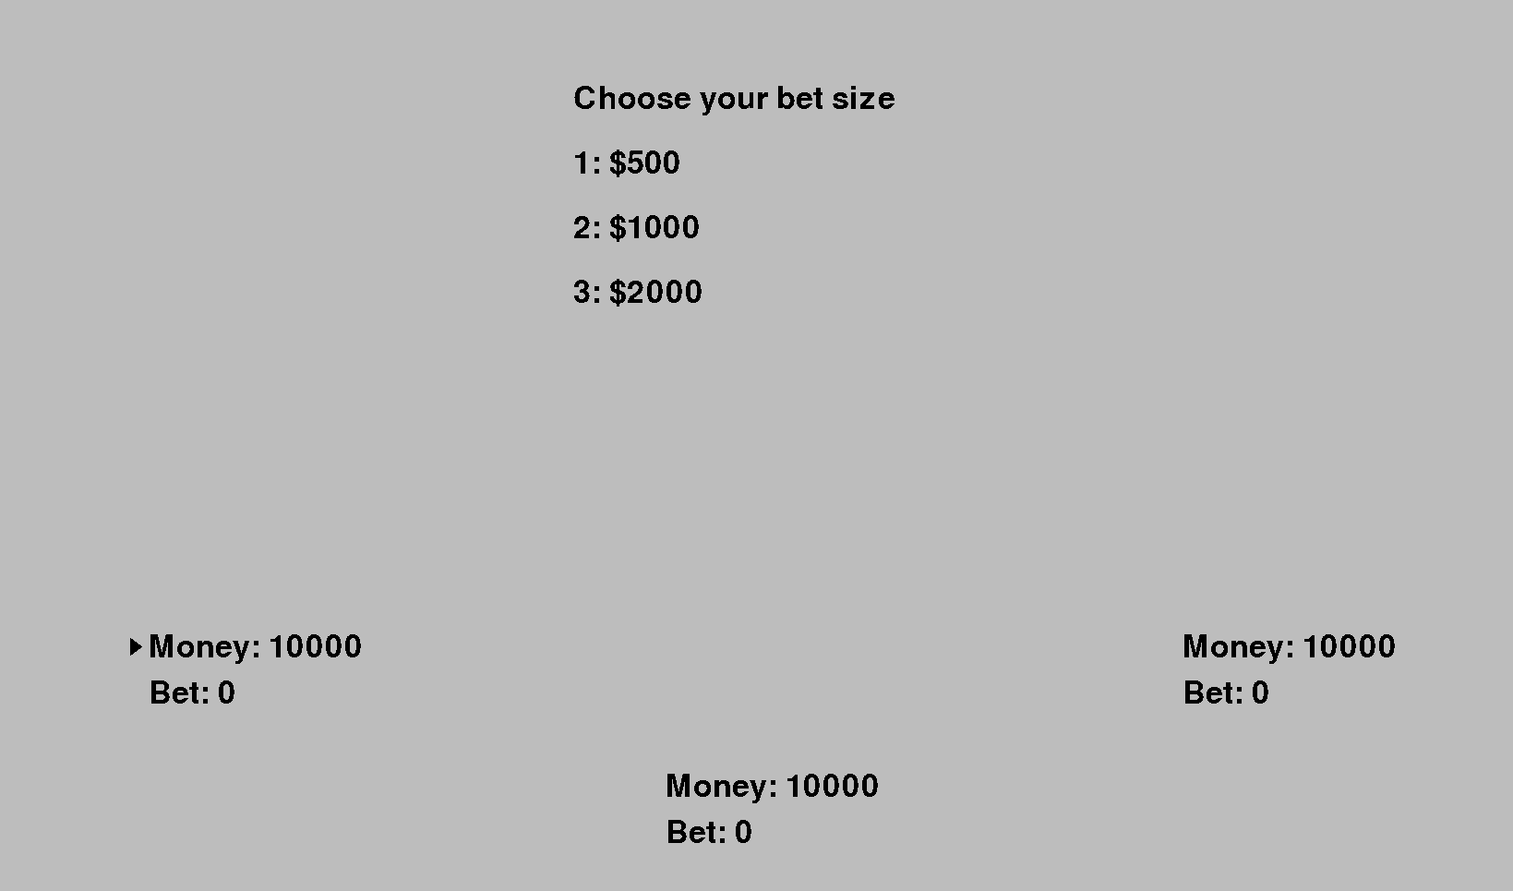
Visual Gameplay for 3-5 Level

Slide 12
3-5 Gameplay
In this game the cards show two special numbers and others two card have its regular numbers.
The art dealer choose the special number, through this kids or students get to know about the special numbers.
This helps helps learner to get knowledge about taking the smart step to tricky things.
Through this games students gain the knowledge about findings patterns by understanding the special numbers.

Slide 13
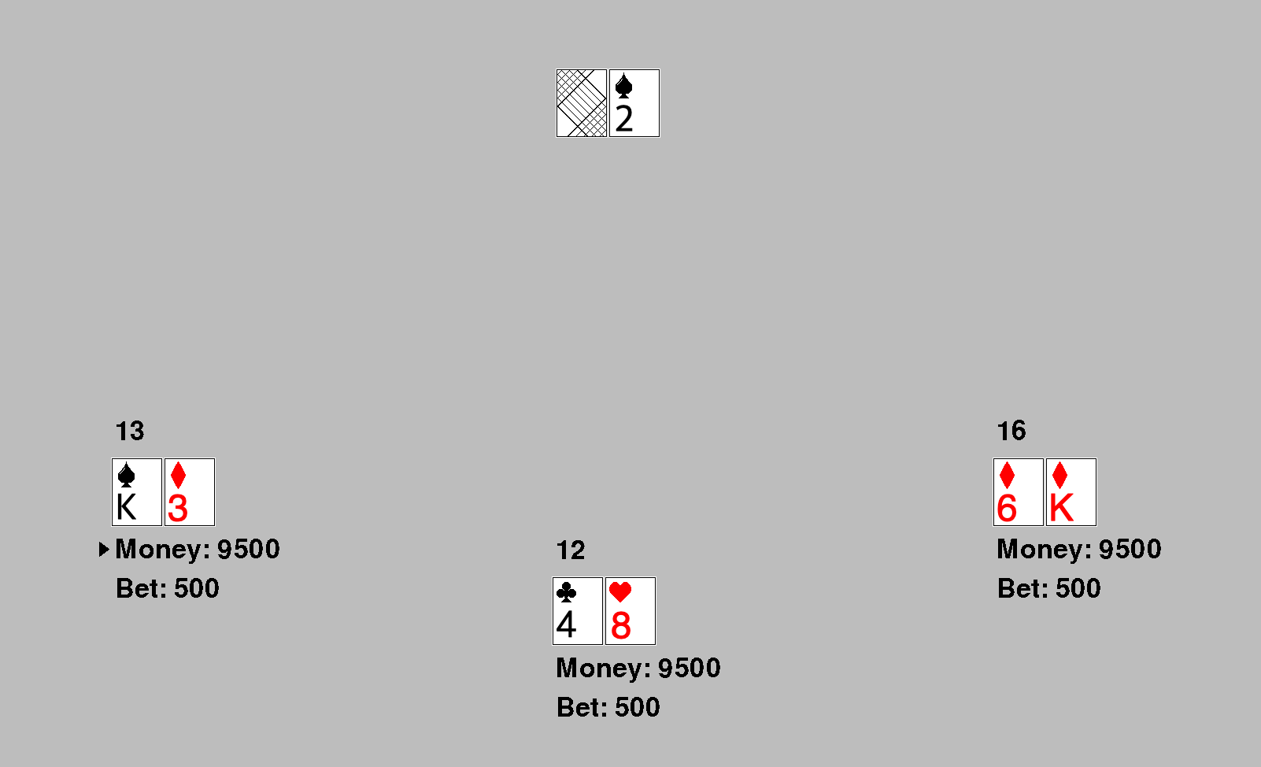
Visual Game Playing for 3- 5 Level

Slide 14
6-8 Level
Moving to Grades 6-8, “The Art Dealer Games” delves into a more profound exploration of patterns and data.
Player encounter intricate combinations common in poker, enhancing their analytical progress.
The game also introduces empower player to make informed judgments based on multifaceted dat, promoting a comprehensive understanding of data analysis.
As they navigate local and big data while reshaping patterns, player embraces challenges mirroring real-world analysis scenarios fostering

Slide 15
6-8 Gameplay
Imagine a scenario where a player presets a and consisting of a flush ( five cards of the same suit) and two pairs (two sets of cards with the same value).
As another player, acting as the art dealer, makes selections bth participants engage in a dynamic interaction.
The dealer’s choice the seller’s interpretation as they decipher the dealer’s inclination towards specific hand compositions.
This interactive aspect not only refines analytical skills but also has the ability to adapt strategies based on evolving data and opponents choices.

Slide 16
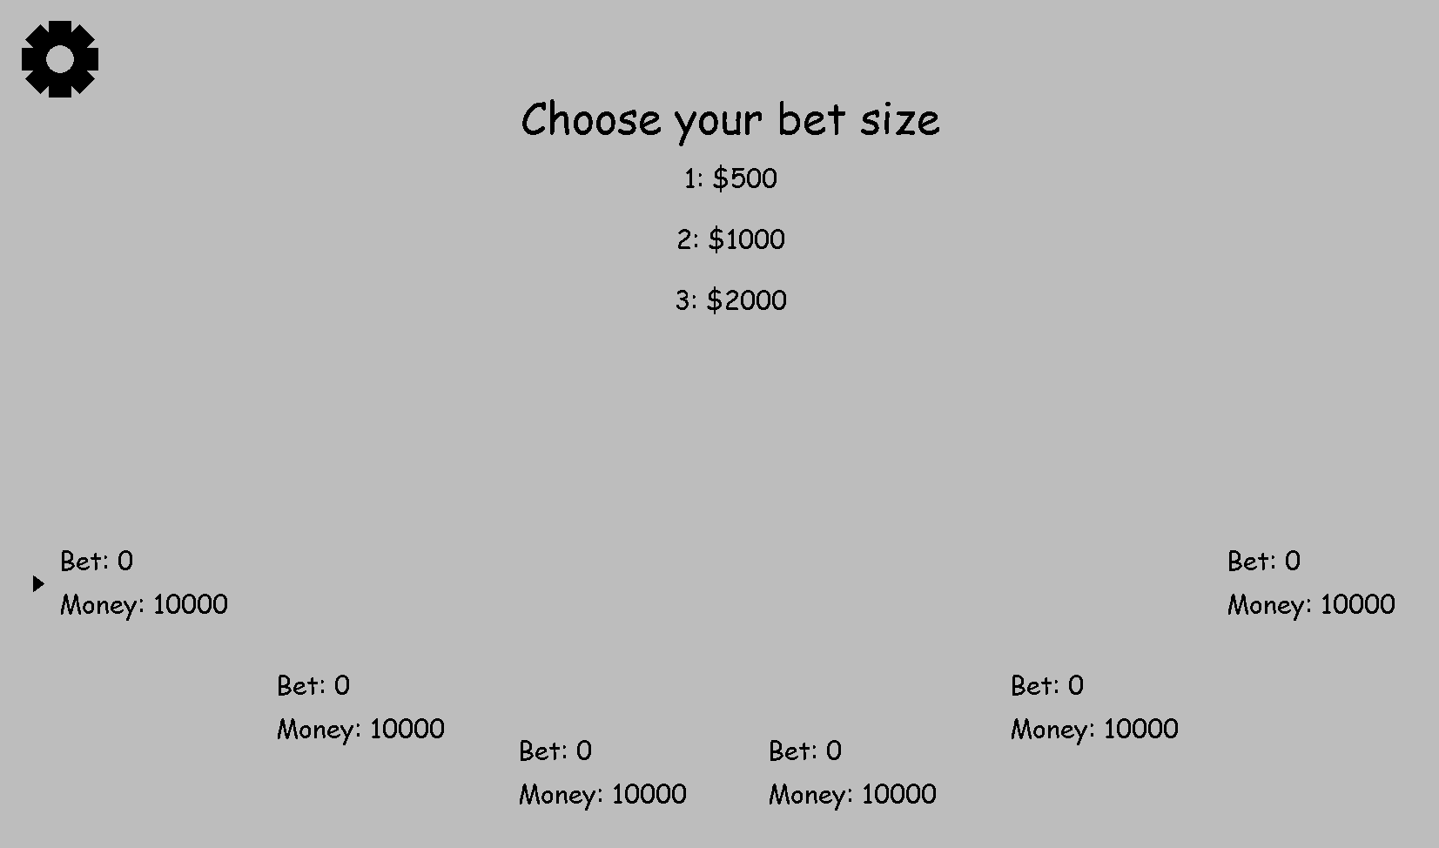
Visual Game play for 6-8 Level

Slide 17
Skill Progression
Throughout the stages of “The Art Dealer Game,” an intriguing phenomenon images- gamers experience a shortened learning curve as they advance.
As they transition from k-2 to 3-5 and 6-8, the skills developed in previous levels lay a solid foundation for tackling more complex challenges.
This incremental approach boosts game’s confidence in deciphering intricate patterns and analytical skills but also build a reservoir of confidence that propels them forward, fostering a seamless journey of growth and achievement.

Slide 18
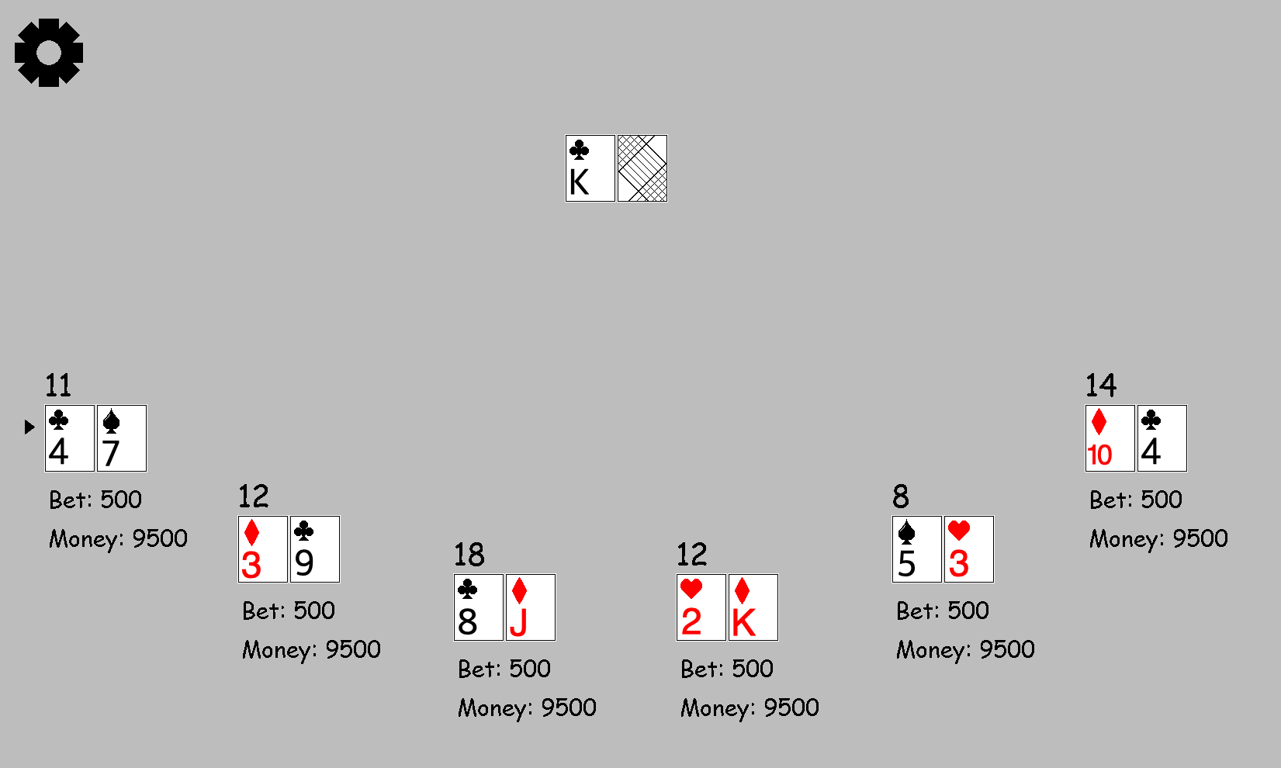
Visual Consistency

Slide 19
Interactive Learning
“The Art Dealer Game” thrives on its interactive design, inviting layers to embark on a hands on learning journey.
By actively selecting cards, player exercise decision making skills.
As they lay out cards and witness the art dealer’s choice, they engage in a dynamic process of data observation and interpretation.
This immersive experience fosters critical ti king as gamer draw conclusions about patterns and data relationships.
Through this process, gamer grasp the power of learning through interaction, reinforcing the notion that active participation amplifies the understanding of complex concepts.

Slide 20
Real World Relevance
The game of art dealer provide information and teaches students and kids to importance of understand the visual data and understand the information.
This game helps students and kids to understand the real world experience for everyday life.
Through this game kids learn about to make good decisions by the things they seen.
This game helps students to get better knowledge and get understanding of similar product and different products.

Slide 21
Conclusion
In Conclusion, “The Art Dealer Game” presents an innovative and engaging platform for players to passively enhance their patterns recognition and data analysis skills.
Through its tailored tags from k-2 to 3-5 and 6-8, players unlock increasingly intricate patterns and conqueror challenges with growing confidences.
This interactive learning journey equips them with invaluable cognitive tools that extend far beyond the game itself.
As a new gamer on this adventure, the dealers encourage gamer to embrace the excitement of learning, fostering critical thinking and ability to decode patterns in both cards and the the world around.

Slide 22
References
Sommerville, I. (2020). Engineering software products (Vol. 355). London, UK: Pearson.
Hagberg Enea, P. (2023). The Influences of Concept art: How is game concept art connected to earlier art movements?.
Kim, J. (2023). PokerKit: A Comprehensive Python Library for Fine-Grained Multi-Variant Poker Game Simulations. arXiv preprint arXiv:2308.07327.

